Slide 1


Mirco Höhne
30/12/2021

Slide 2

Outline
Executive Summary
Introduction
Methodology
Results
Conclusion
Appendix

Slide 3
Executive Summary
The Data was collected using the public SpaceX API and Web Scraping the Wikipedia Page of SpaceX
The Data was transformed in order to use it efficiently (Created new labels and encoded categorical labels)
statistics, visualization, SQL, folium maps and dashboards were used to explore the data and find relevant columns to be used as features for the machine learning models
For machine learning models Logistic Regression, Support Vector Machines, Decision Trees and K-Nearest-Neighbors were used. They all performed similarly with an accuracy of 83.33%. For a better accuracy of the model more data would be needed

Slide 4
Introduction
Space Flight is a very costly endeavor
SpaceX successfully cut the cost of its rockets (62 Million USD in comparison to 165 Million USD that other providers charge)
Much of the savings come from reusing the first stage of the rocket
can we use data to predict if the first stage of a rocket lands successfully to use this data to create a company that can compete with SpaceX prices?

Slide 5


Slide 6
Data Collection
Two approaches to Data Collection were used
SpaceX API
Web Scraping the Wikipedia Page of SpaceX

Slide 7
Data Collection – SpaceX API
1. Request Data (from SpaceX API)
2. Receive .JSON File
3. Turn Data into Pandas Dataframe using .json_normalize method
4. Cast relevant Data into Dictionaries (Extract relevant Data)
5. Cast Dictionaries to a new Dataframe
6. Filter Data (only include Falcon 9 Launches)
7. Imputate missing values in “PayloadMass“ column with mean
https://github.com/mircohoehne/IBM_Applied_Data_Science_Capstone/blob/master/1.%20Data_Collection_with_API.ipynb

Slide 8
Data Collection - Scraping
1. Requested the Falcon9 Launch Wiki page from ist url and stored it as a BeautifulSoup object
2. Extracted all column/variable names from the HTML table header
3. Created a dataframe by parsing the launch HTML tables
https://github.com/mircohoehne/IBM_Applied_Data_Science_Capstone/blob/master/2.%20Data_Collection_with_Webscraping.ipynb

Slide 9
Data Wrangling
1. Calculated number of launches per site
2. Calculated the number and occurrence of each orbit
3. Calculated the number and occurence of mission outcome per orbit type
4. Created a landing outcome label from the „Outcome“ column
https://github.com/mircohoehne/IBM_Applied_Data_Science_Capstone/blob/master/3.%20Data_wrangling.ipynb

Slide 10
EDA with Data Visualization
For the visualization Bar Charts were used, when showing two-dimensional Data, Scatterplots for three-dimensional data and line charts for time series data in order to visualize the relationship between the variables
The Plots where:
Relationship between Launch Site, Flight Number and Class
Relationship between Payload Mass, Launch Site and Class
Relationship between Success Rate and Orbit Type
https://github.com/mircohoehne/IBM_Applied_Data_Science_Capstone/blob/master/5.%20eda_dataviz_python.ipynb

Slide 11
EDA with SQL
Performed SQL queries:
names of unique launch sites in the space mission
five records where launch sites begin with the string ‘CCA’
total payload mass carried by boosters launched by NASA (CRS)
average payload mass carried by booster version F9 v1.1
date when first successful landing outcome in ground pad was achieved
list names of bossters which have success in drone ship and have payload mass between 4000 and 6000
total number of successful and failure mission outcomes
names of bosster_versions which have carried the maximum payload mass
List failed landing_outcomes in drone ship, their booster versions, and laucnch site names in year 2015
Rank count of landing outcomes between date 2010-06-04 and 2017-03-20, in descending order
https://github.com/mircohoehne/IBM_Applied_Data_Science_Capstone/blob/master/4.%20eda-sql.ipynb

Slide 12
Build an Interactive Map with Folium
1. Marked all launch sites on Map using circles with labels and markers
2. Marked the success/failed launches for each site on the map using marker clusters
3. Calculated the distances between a launch site to ist proximities (railroads, highways, cities, coastline)
Different Points of interest were marked in order to gain new knowledge from the visualizations
https://github.com/mircohoehne/IBM_Applied_Data_Science_Capstone/blob/master/6.%20launch_site_geo_visualization.ipynb

Slide 13
Build a Dashboard with Plotly Dash
Dashboard consists of:
Pie Chart for successful launches (all sites in one pie chart and a pie chart for every site)
Scatterplot showing the relationship between Payload Mass, class and Booster Version of all sites
https://github.com/mircohoehne/IBM_Applied_Data_Science_Capstone/blob/master/7.%20spacex_dash_app.py

Slide 14
Predictive Analysis (Classification)
Create numpy array with class values
standardize the data
split the data (Train/Test split)
create machine learning objects (logistic regression, svm, decision tree, knn)
use gridsearch to search for optimal parameters
find the method that works best using the accuracy score
https://github.com/mircohoehne/IBM_Applied_Data_Science_Capstone/blob/master/8.%20ml_prediction.ipynb

Slide 15


Slide 16
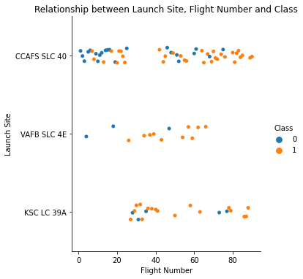
Flight Number vs. Launch Site
we can see, that the number of failed landings (of the first stage) decreases with higher flight numbers.
This makes sense, because with more experience better systems may be implemented in the first stage

Slide 17
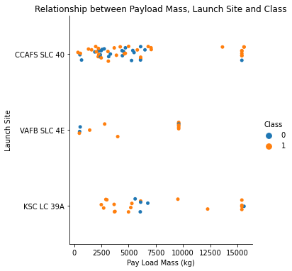
Payload vs. Launch Site
with very high Payload Mass the success rate is also higher than with lower payload mass

Slide 18
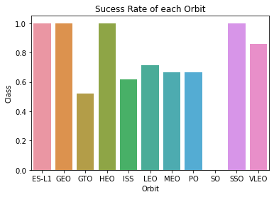
Success Rate vs. Orbit Type
ES-L1, GEO, HEO and SSO have the highest success rates

Slide 19
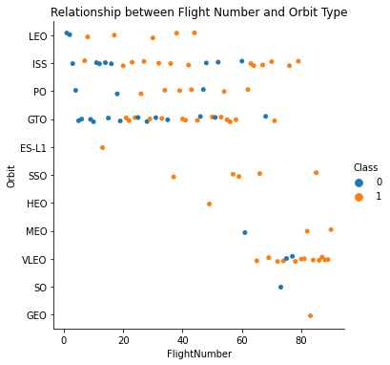
Flight Number vs. Orbit Type
in the LEO orbit the Success appears related to the number of flights;
on the other hand, there seems to be no relationship between flight number when in GTO orbit

Slide 20
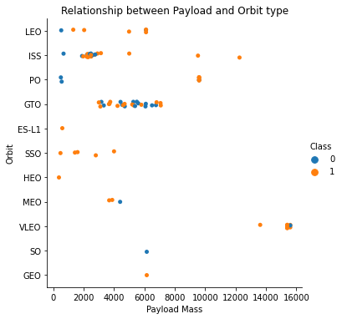
Payload vs. Orbit Type
With heavy payloads the successful landing or positive landing rate are more for Polar,LEO and ISS.
However for GTO we cannot distinguish this well as both positive landing rate and negative landing(unsuccessful mission) are both there here.

Slide 21
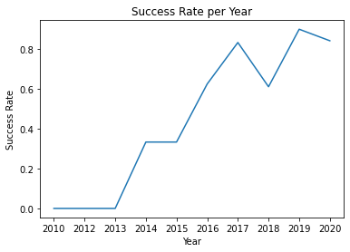
Launch Success Yearly Trend
you can observe that the sucess rate since 2013 kept increasing till 2020

Slide 22
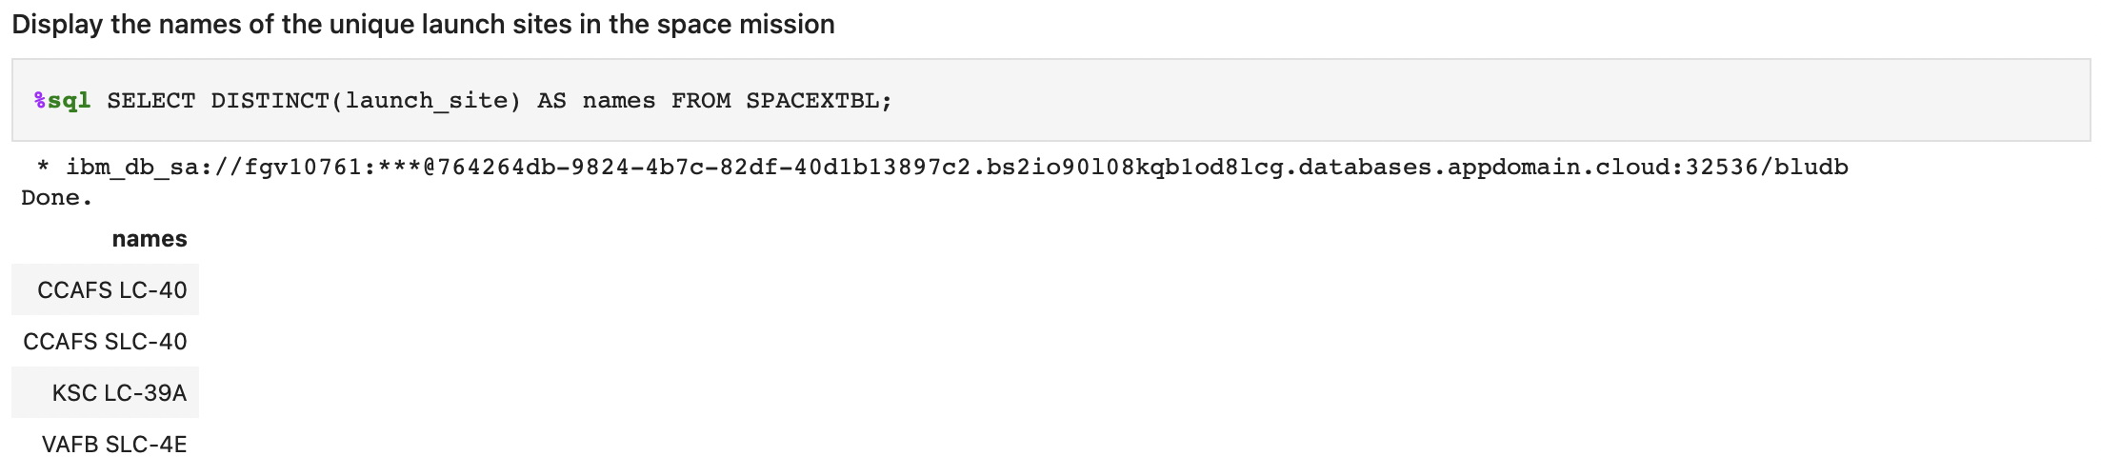
All Launch Site Names
Find the names of the unique launch sites

Slide 23
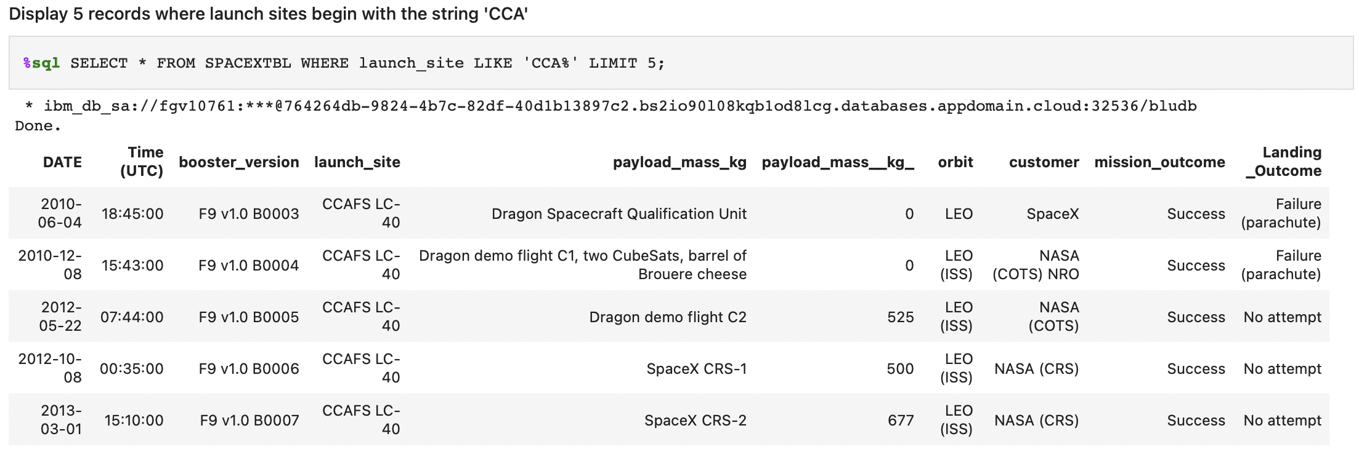
Launch Site Names Begin with 'CCA'
Find 5 records where launch sites begin with `CCA`

Slide 24
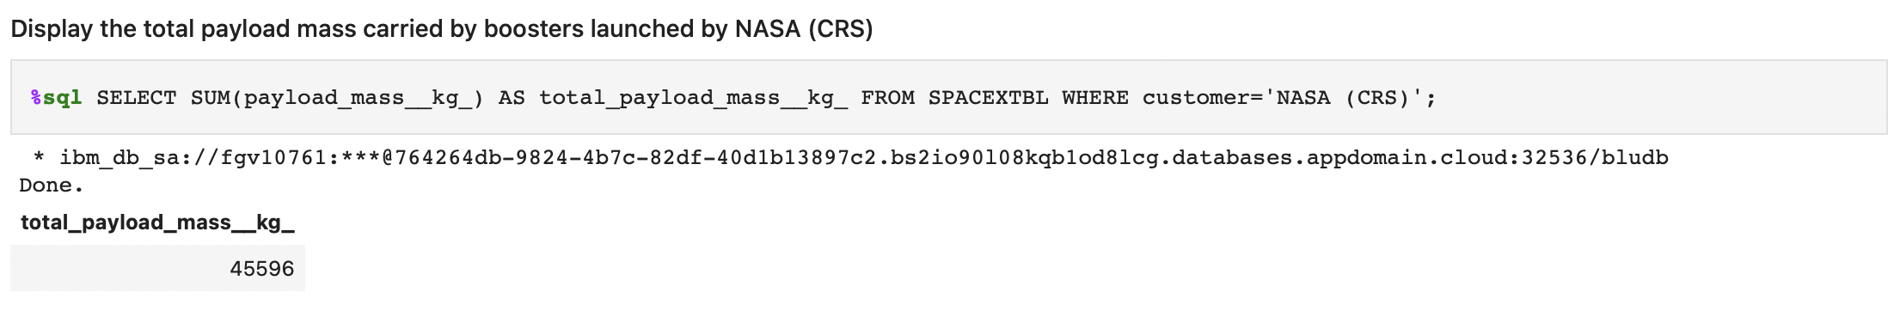
Total Payload Mass
Calculate the total payload carried by boosters from NASA

Slide 25
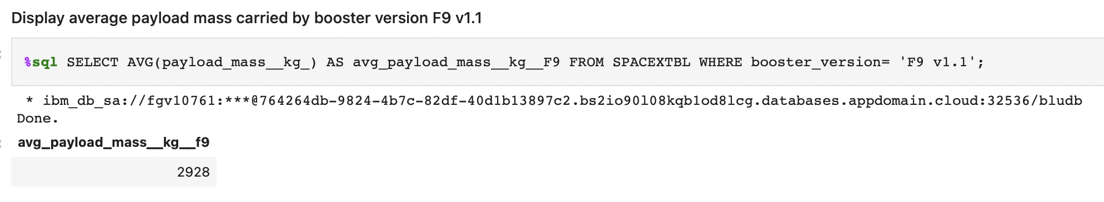
Average Payload Mass by F9 v1.1
Calculate the average payload mass carried by booster version F9 v1.1

Slide 26
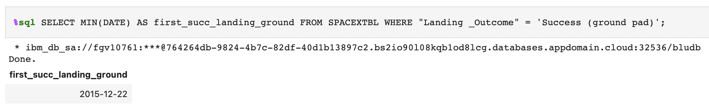
First Successful Ground Landing Date
Find the dates of the first successful landing outcome on ground pad

Slide 27
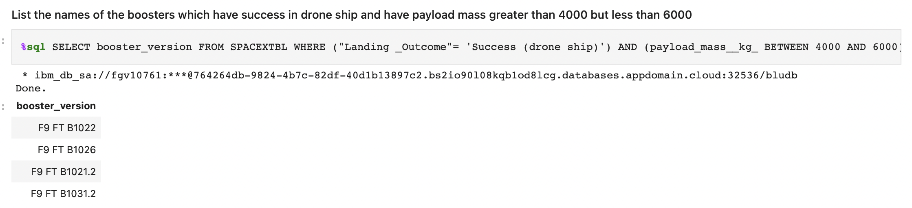
Successful Drone Ship Landing with Payload between 4000 and 6000
List the names of boosters which have successfully landed on drone ship and had payload mass greater than 4000 but less than 6000

Slide 28
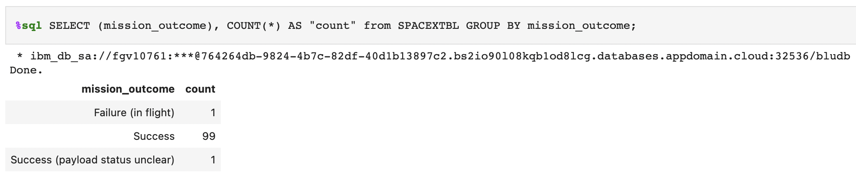
Total Number of Successful and Failure Mission Outcomes
Calculate the total number of successful and failure mission outcomes

Slide 29
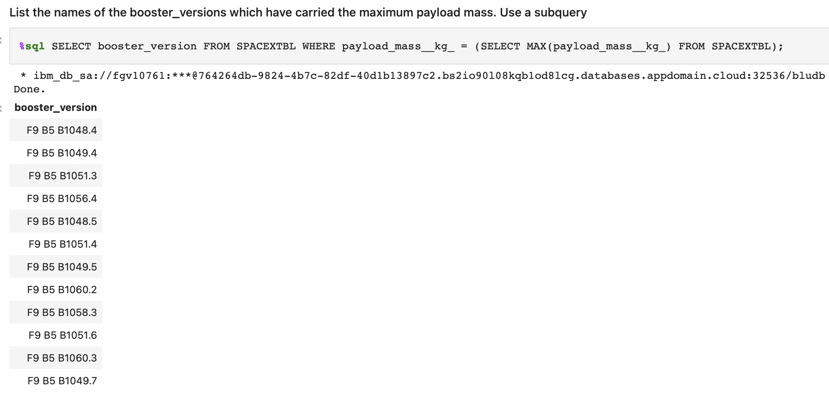
Boosters Carried Maximum Payload
List the names of the booster which have carried the maximum payload mass

Slide 30
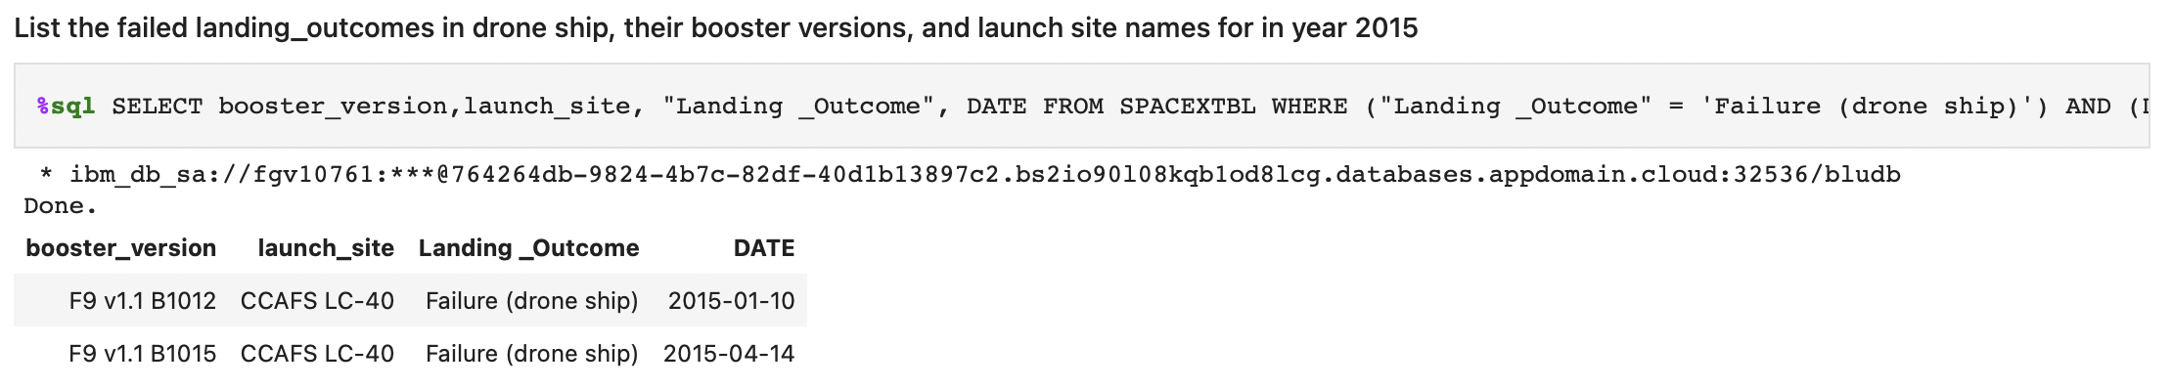
2015 Launch Records
List the failed landing_outcomes in drone ship, their booster versions, and launch site names for in year 2015

Slide 31
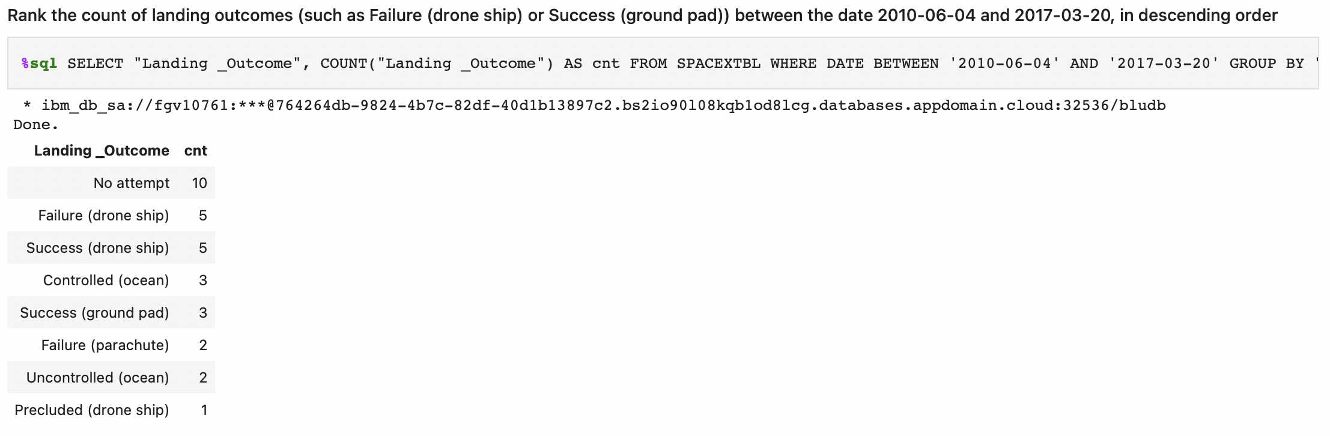
Rank Landing Outcomes Between 2010-06-04 and 2017-03-20
Rank the count of landing outcomes (such as Failure (drone ship) or Success (ground pad)) between the date 2010-06-04 and 2017-03-20, in descending order

Slide 32


Slide 33
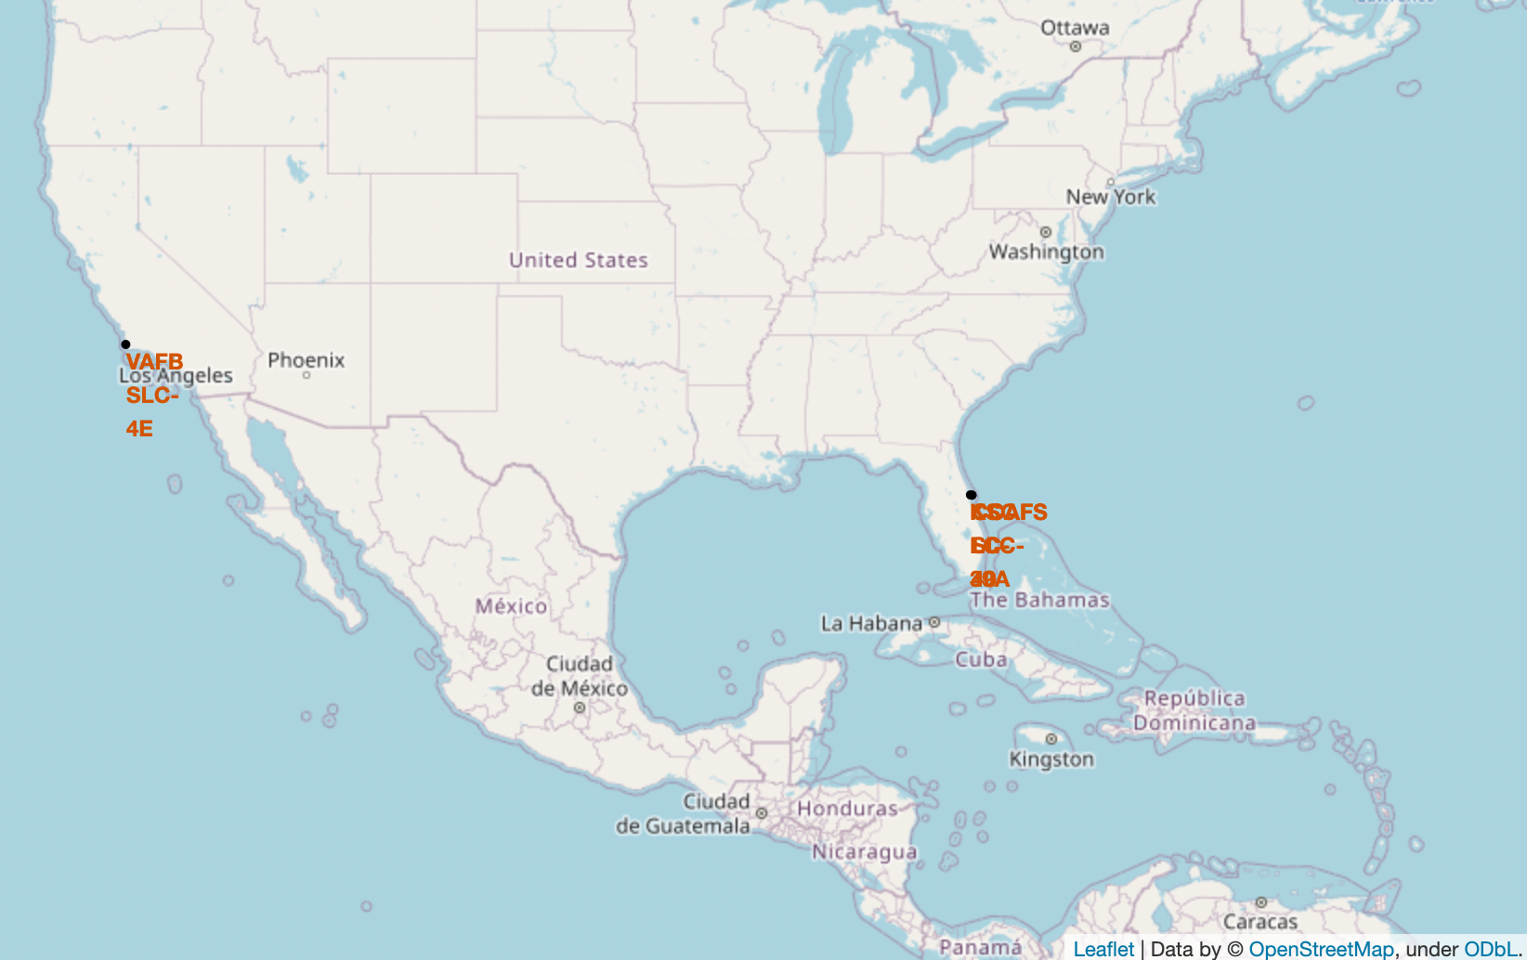
Launch Site Locations I
Map shows the Launch Site Locations
All Launch Sites are near the ocean

Slide 34
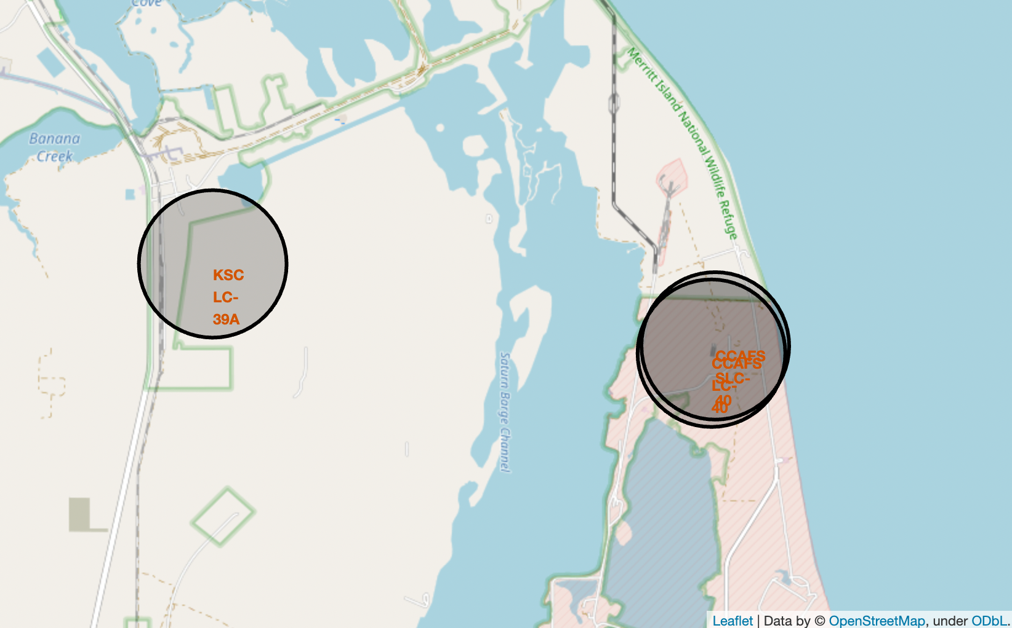
Launch Site Locations II
Map shows the launch sites in Florida, since they are close together

Slide 35
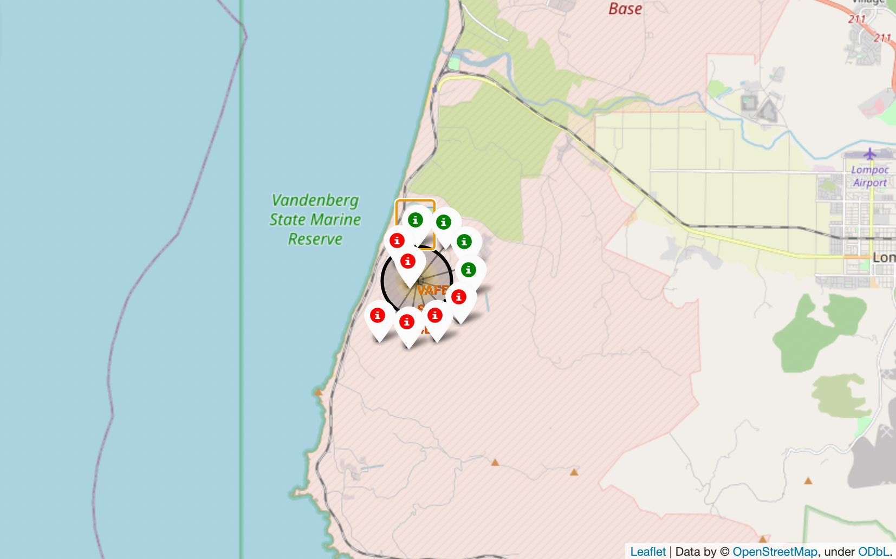
Color-labeled launch outcomes
color-labeled marker clusters where placed on the map to show the launch was successful (green) or unsuccessfull (red)

Slide 36
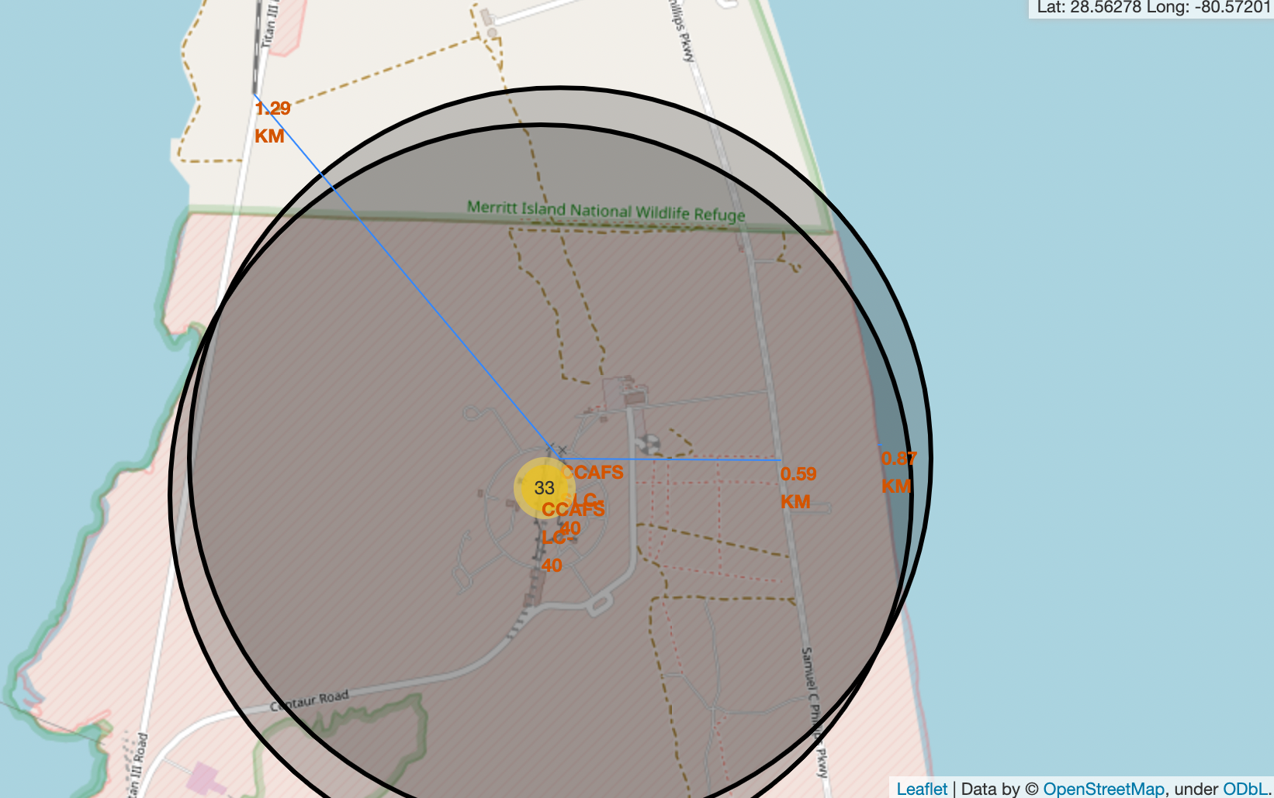
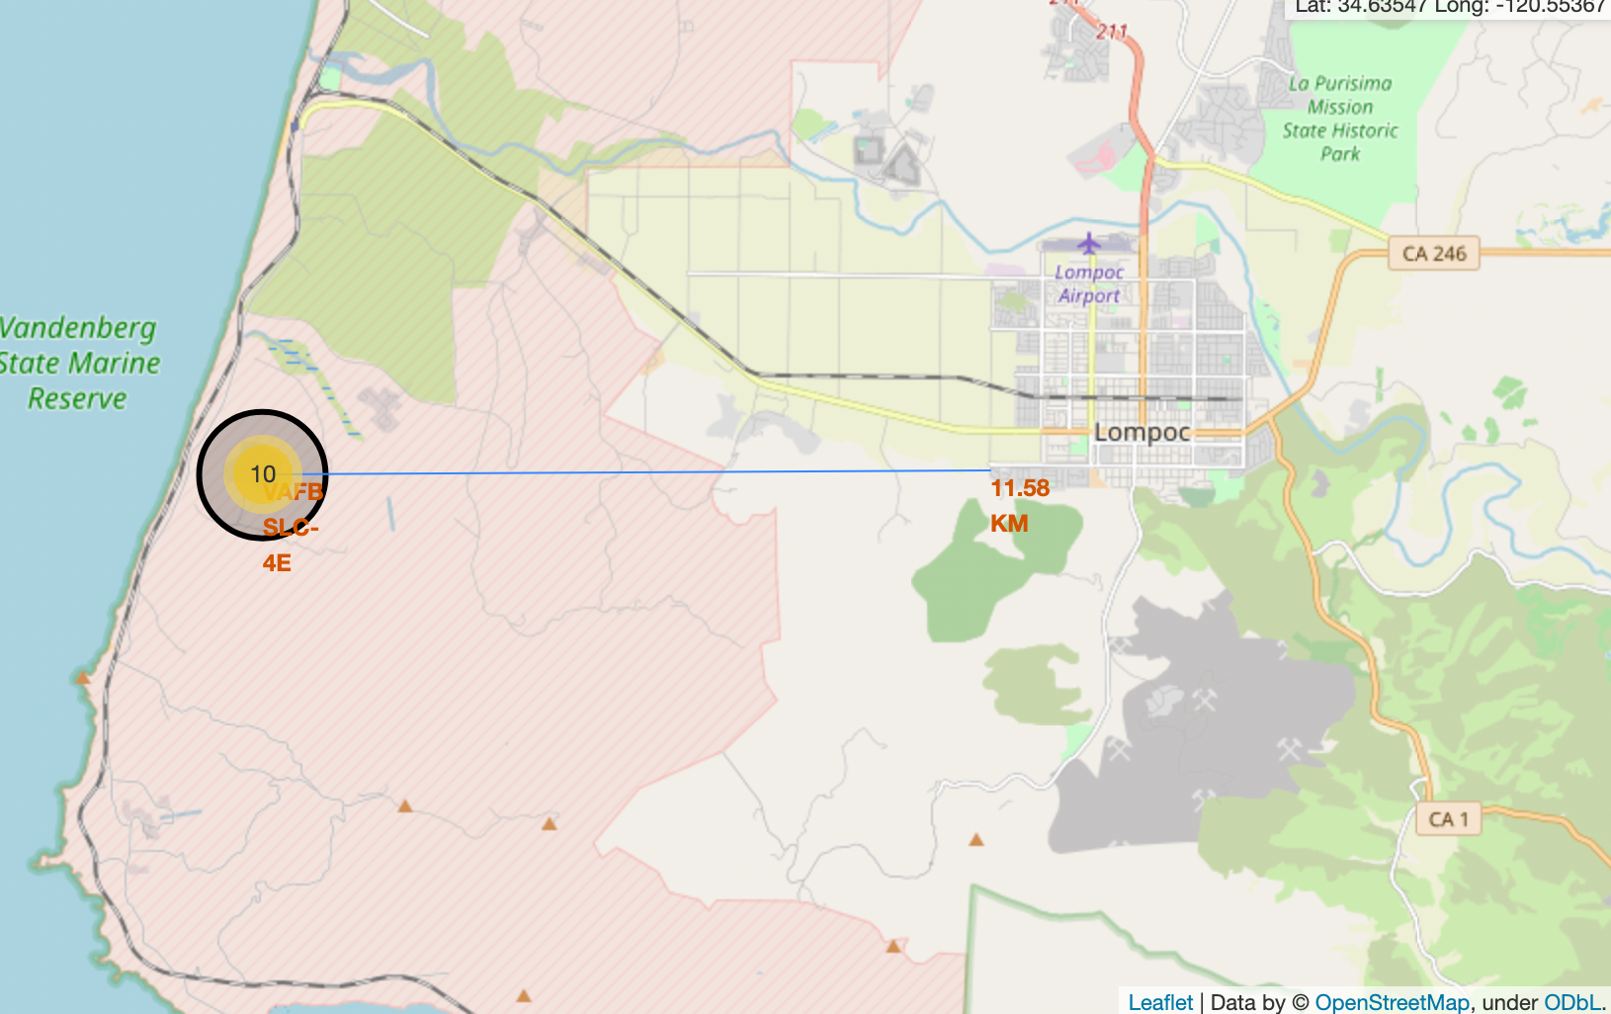
Proximity Analysis
The Screenshots show the proximity to the nearby cities, railways and highways

Slide 37


Slide 38
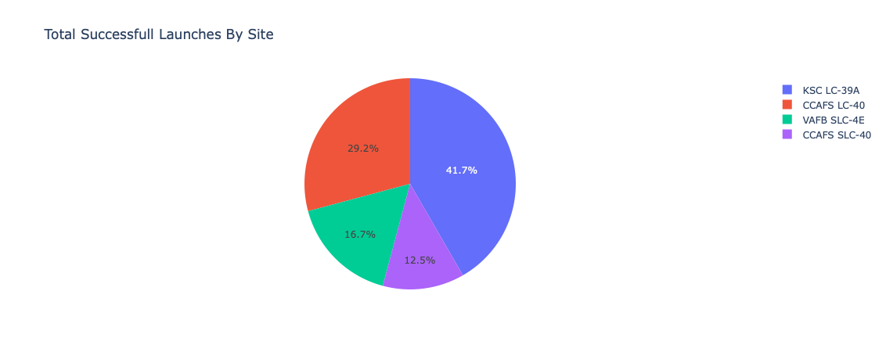
Total successful Launches ratio per Site
KSC LC-39A has the best ratio for successful launches

Slide 39
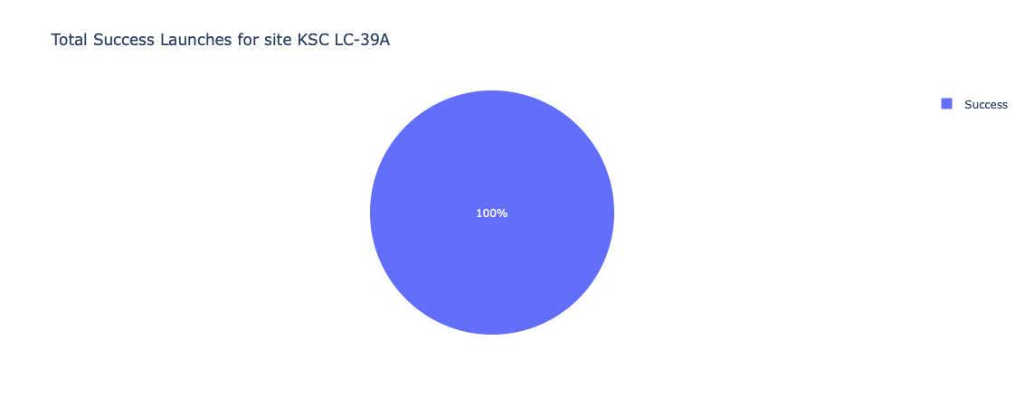
Successful Launch Ratio for KSC LC-39A
The succesful launch Ratio for KSC LC-39A is 100%

Slide 40
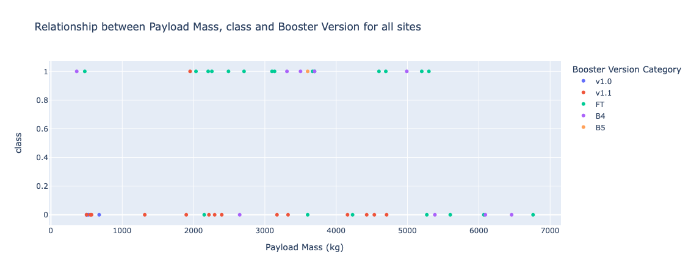
Successful/Failed Landings for different Payload Sizes and Booster Versions
Plotly dashboard has a Payload range selector. However, this is set from 0-7500 instead of the maximum Payload of 15600. Class indicates 1 for successful landing and 0 for failure. Scatter plot also accounts for booster version category in color.

Slide 41


Slide 42
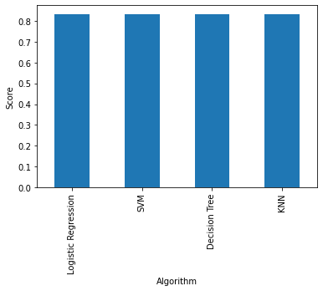
Classification Accuracy
This Visualization shows the accuracy score of the different Algorithms
As you can see all Algorithms perform equally good, so every one of this models could be chosen

Slide 43
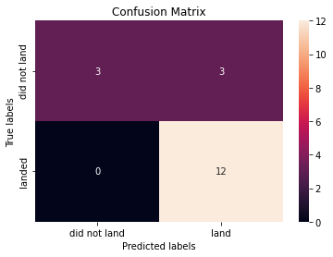
Confusion Matrix
All models perform equally good, and the confusion matrices are the same
the screenshot shows the confusion matrix of the k-Nearest Neighbors Algorithm
You can see that the Algorithm predicted 15 Instances correctly (3 did not land and 12 landed)
three Instances where predicted false as landed while they did not land (false positive)

Slide 44
Conclusions
Our task: to develop a machine learning model for Space Y who wants to bid against SpaceX
The goal of model is to predict when Stage 1 will successfully land to save cost
Used data from a public SpaceX API and web scraping SpaceX Wikipedia page
Created data labels and stored data into a DB2 SQL database
Created a dashboard for visualization
We created a machine learning model with an accuracy of 83%
Allon Mask of SpaceY can use this model to predict with relatively high accuracy whether a launch will have a successful Stage 1 landing before launch to determine whether the launch should be made or not
If possible more data should be collected to better determine the best machine learning model and improve accuracy

Slide 45
Appendix
Github Url:
https://github.com/mircohoehne/IBM_Applied_Data_Science_Capstone

Slide 46


